Slide 1

Go, change the world
RV College of
Engineering
Hydrogen Energy
UNIT 3

Slide 2

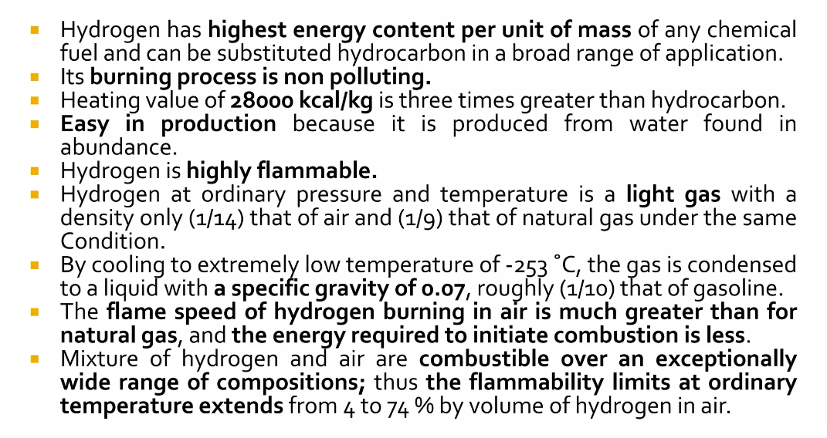
Introduction
RV College of
Engineering®
Go, change the world

Slide 3
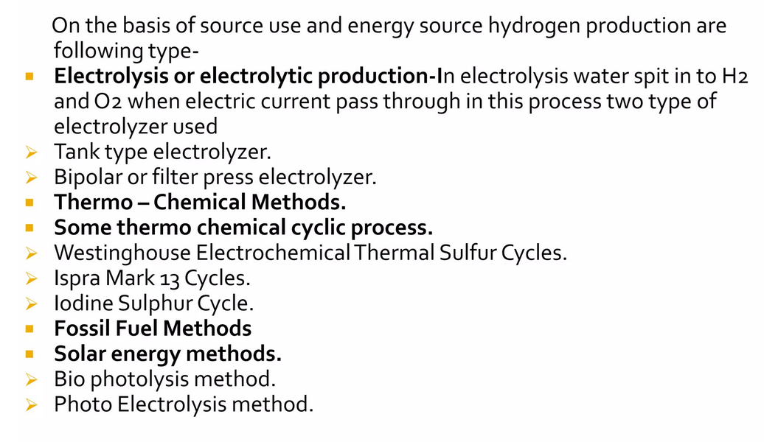
RV College of
Engineering®
Types of Hydrogen Production
Go, change the world

Slide 4
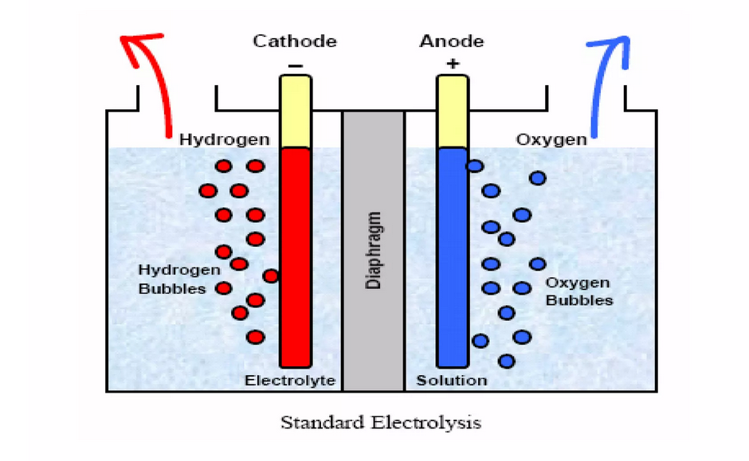
Electrolysis
RV College of
Engineering®
Go, change the world

Slide 5
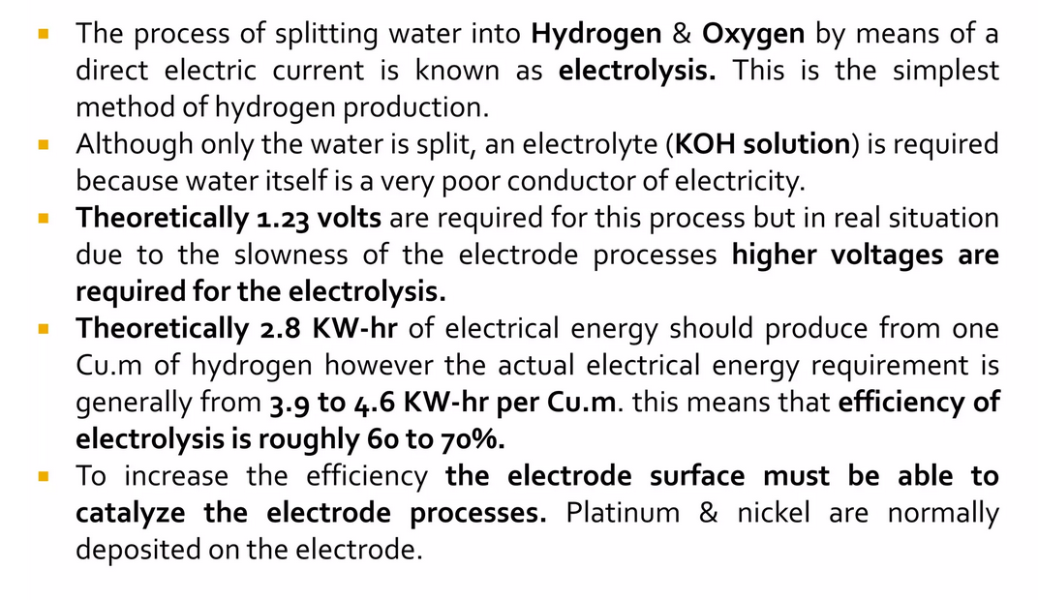
Electrolysis
RV College of
Engineering®
Go, change the world

Slide 6
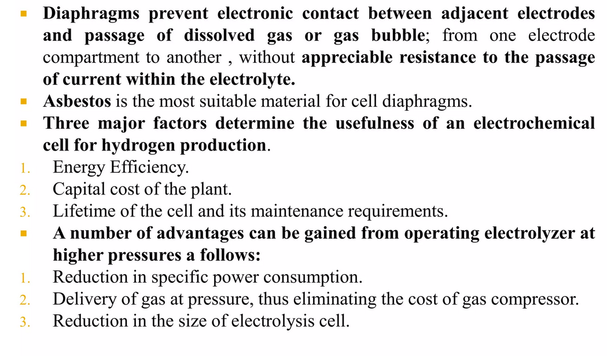
Introduction
RV College of
Engineering®
Go, change the world

Slide 7
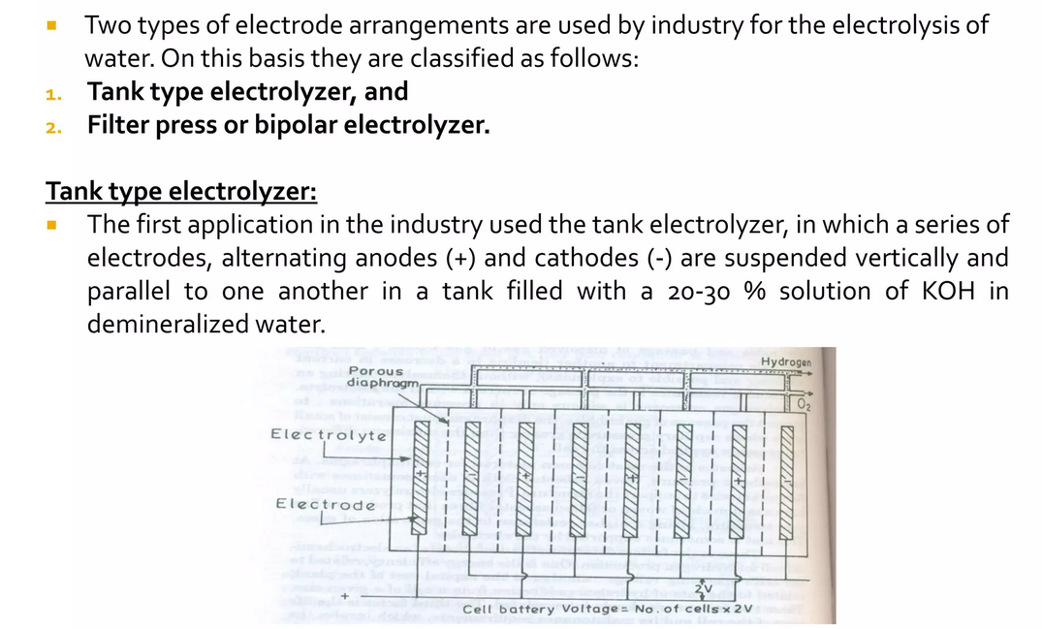
Electrolyser
RV College of
Engineering®
Go, change the world

Slide 8
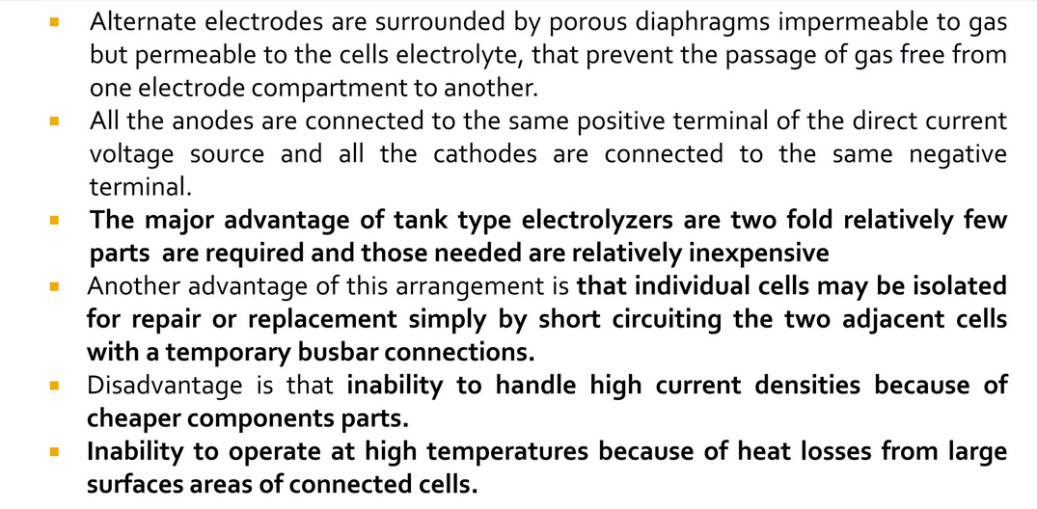
Electrolyser
RV College of
Engineering®
Go, change the world

Slide 9
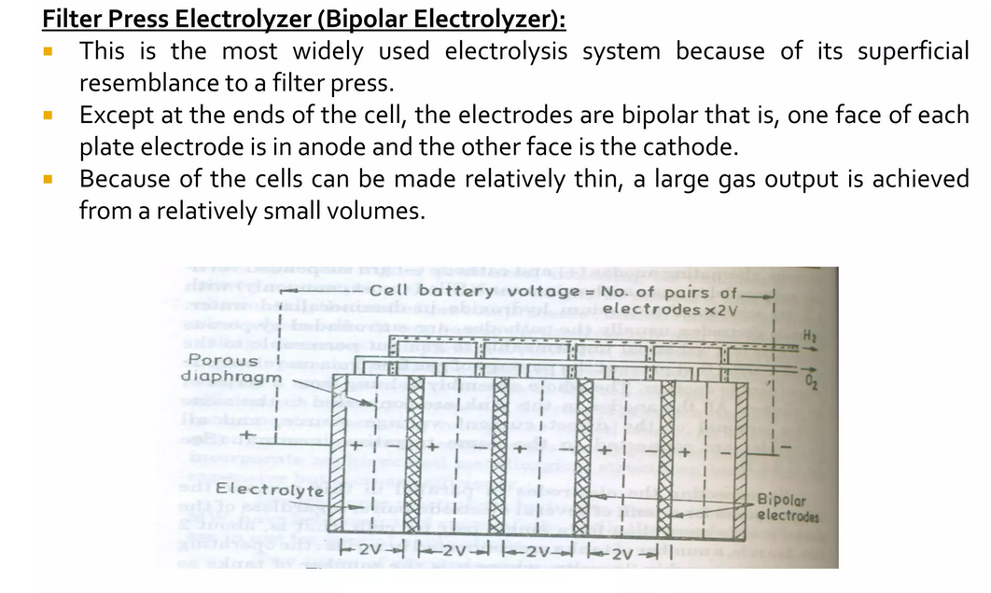
Electrolyser
RV College of
Engineering®
Go, change the world

Slide 10
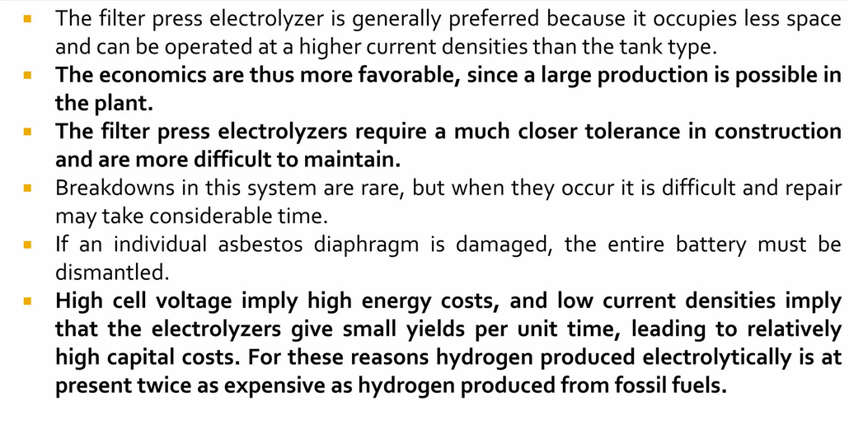
Electrolyser
RV College of
Engineering®
Go, change the world

Slide 11
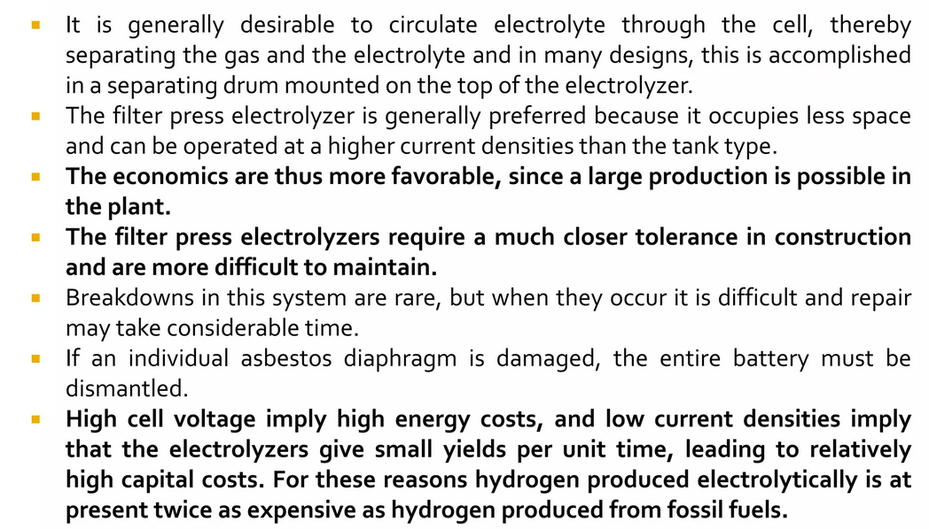
Electrolyser
RV College of
Engineering®
Go, change the world

Slide 12
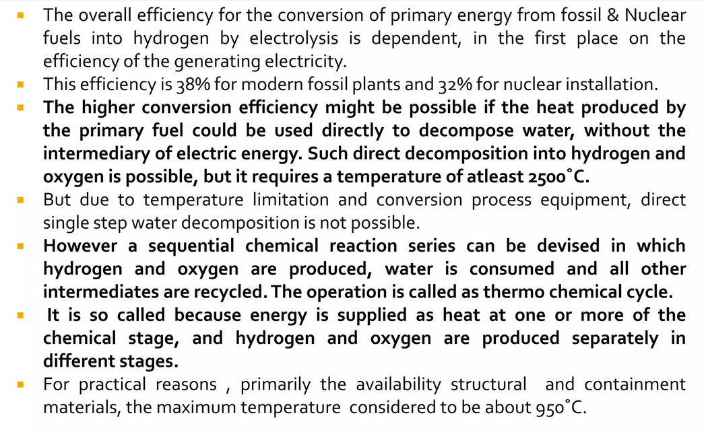
Thermo Chemical Methods
RV College of
Engineering®
Go, change the world

Slide 13
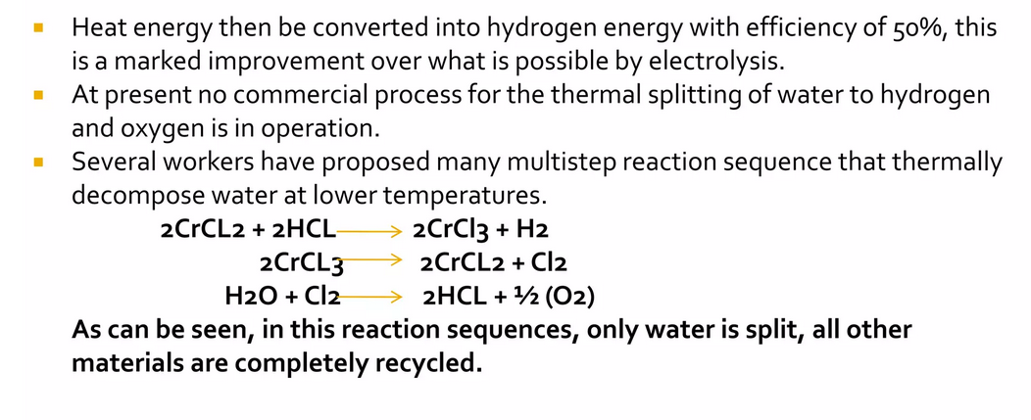
Conti….
RV College of
Engineering®
Go, change the world

Slide 14
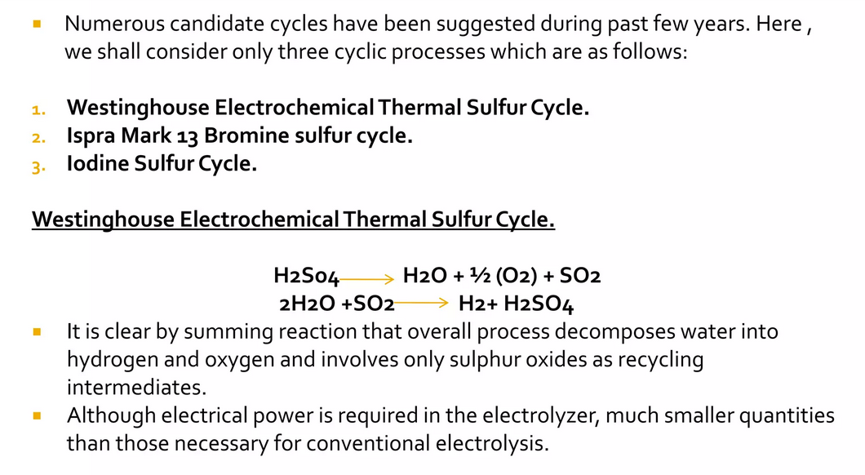
Conti
RV College of
Engineering®
Go, change the world

Slide 15
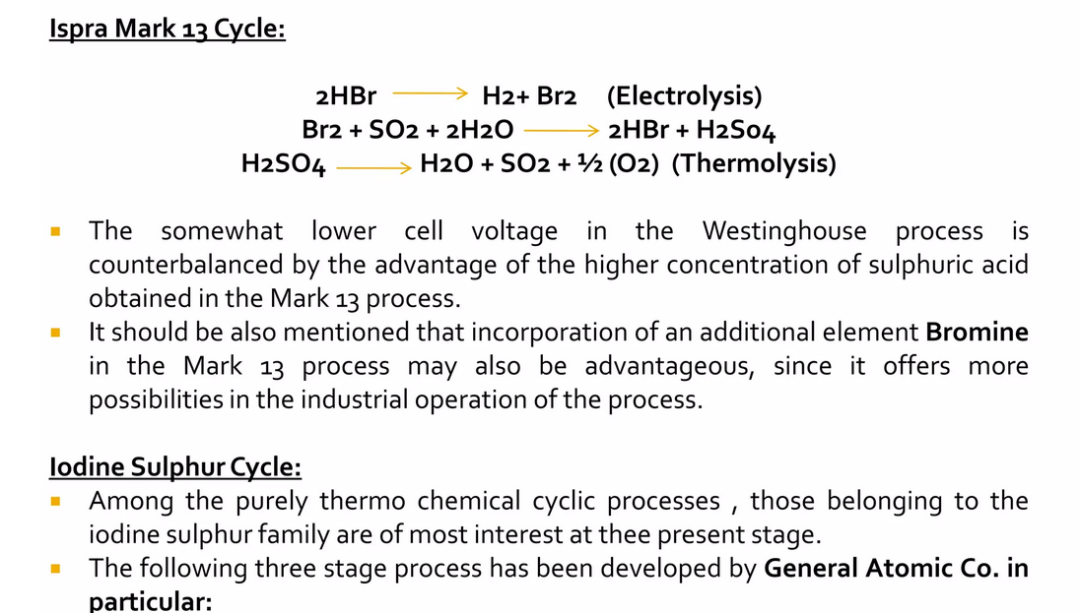
Conti
RV College of
Engineering®
Go, change the world

Slide 16
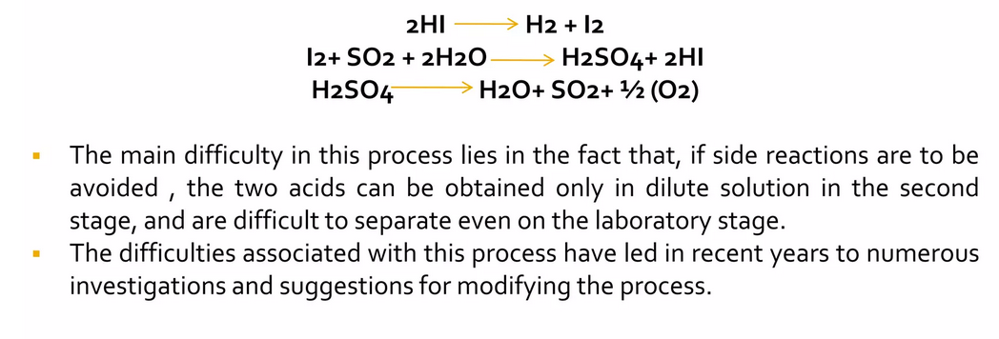
Conti..
RV College of
Engineering®
Go, change the world

Slide 17
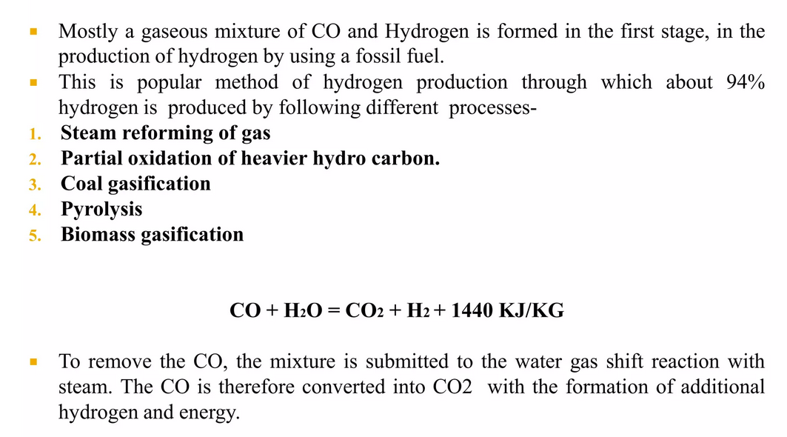
Fossil Fuel Method
RV College of
Engineering®
Go, change the world

Slide 18
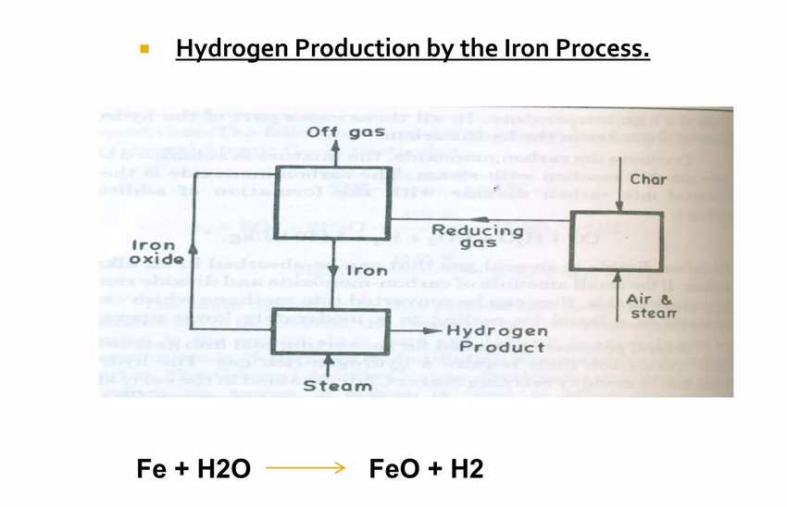
Conti..
RV College of
Engineering®
Go, change the world

Slide 19
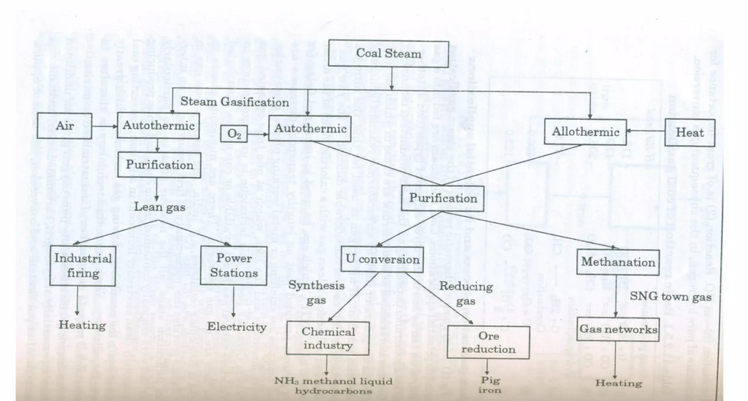
RV College of
Engineering®
Steam Gasification Process and Applications
Go, change the world

Slide 20
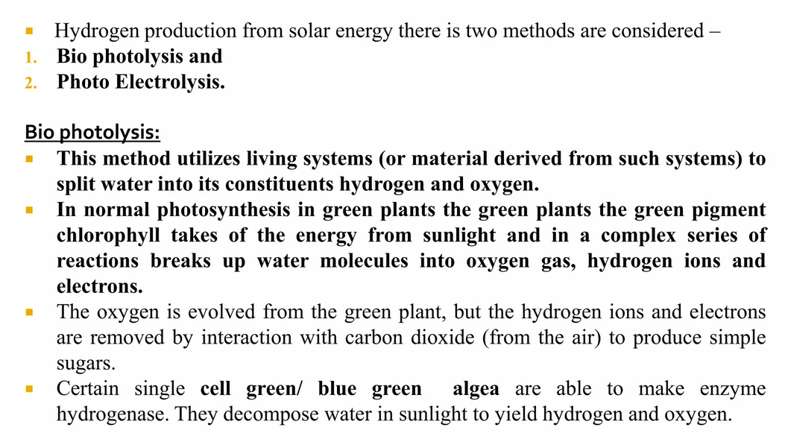
Solar Energy Method
RV College of
Engineering®
Go, change the world

Slide 21
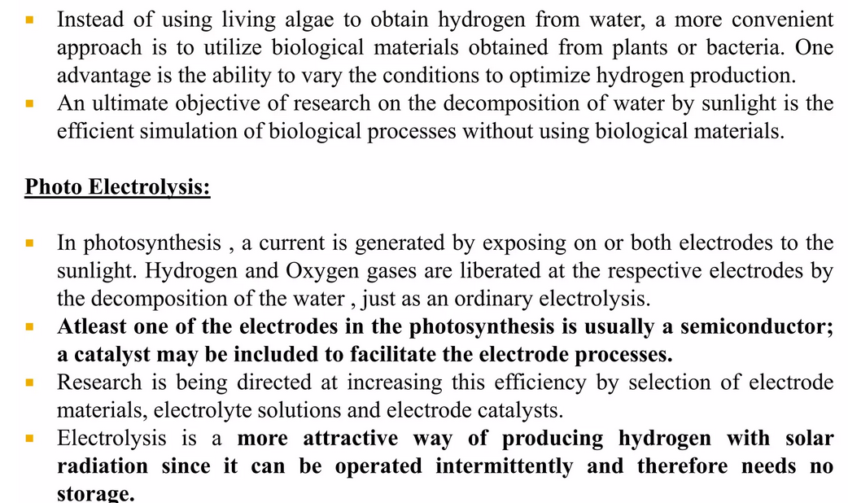
Solar Energy Method
RV College of
Engineering®
Go, change the world

Slide 22
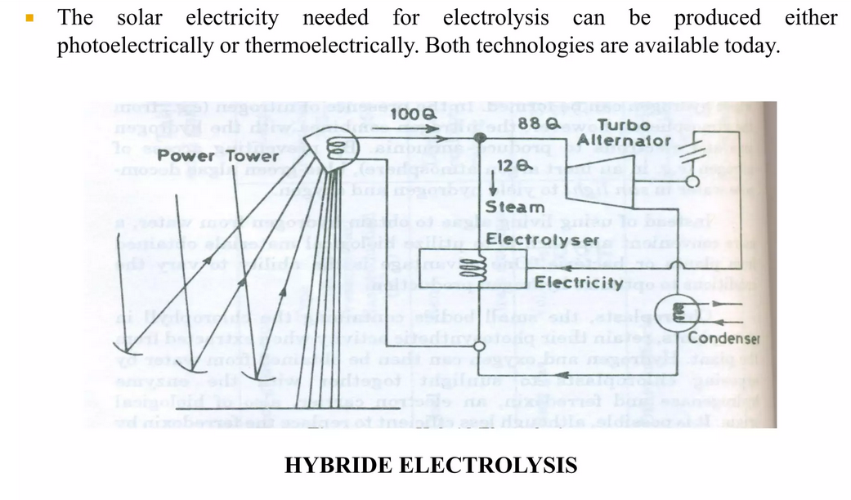
Solar Energy Method
RV College of
Engineering®
Go, change the world

Slide 23
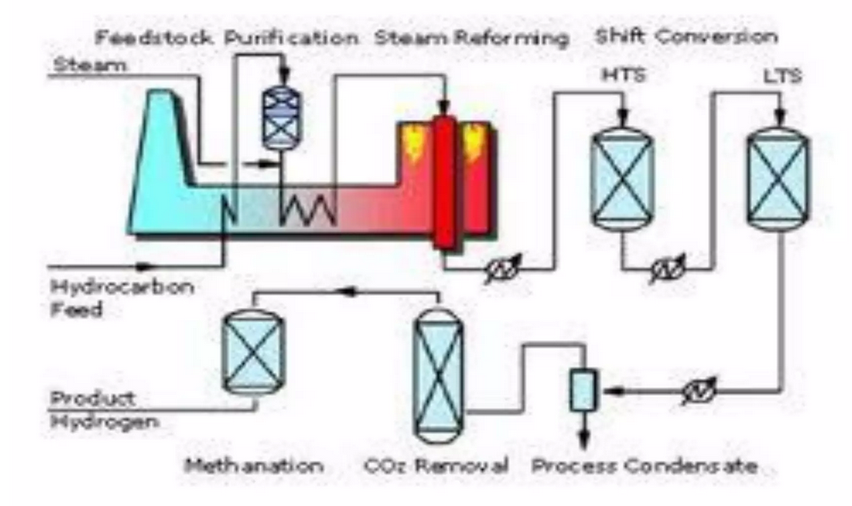
Steam Methane Reformer Process
RV College of
Engineering®
Go, change the world

Slide 24
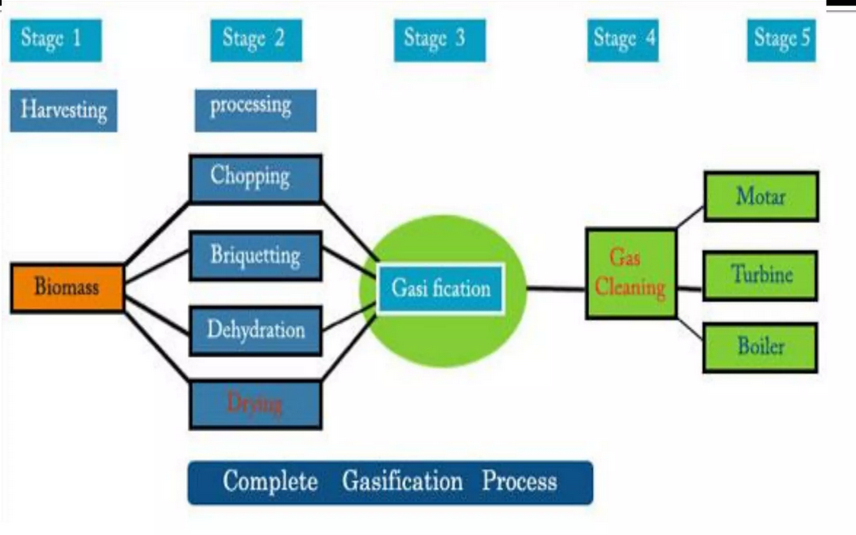
Gassification Process
RV College of
Engineering®
Go, change the world

Slide 25
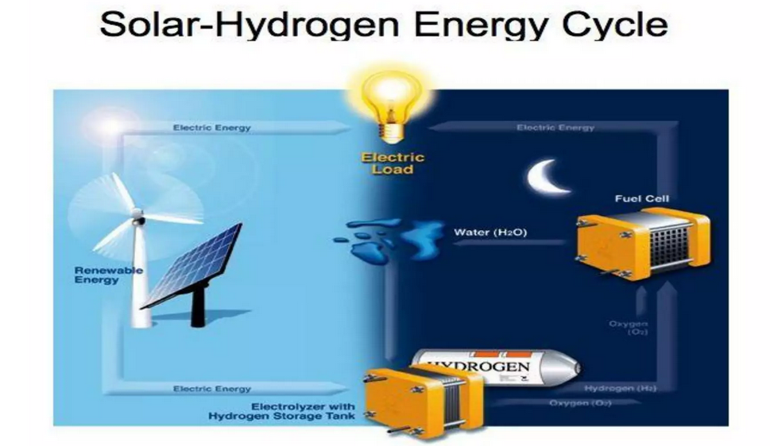
Basic Hydrogen Cycle
RV College of
Engineering®
Go, change the world

Slide 26
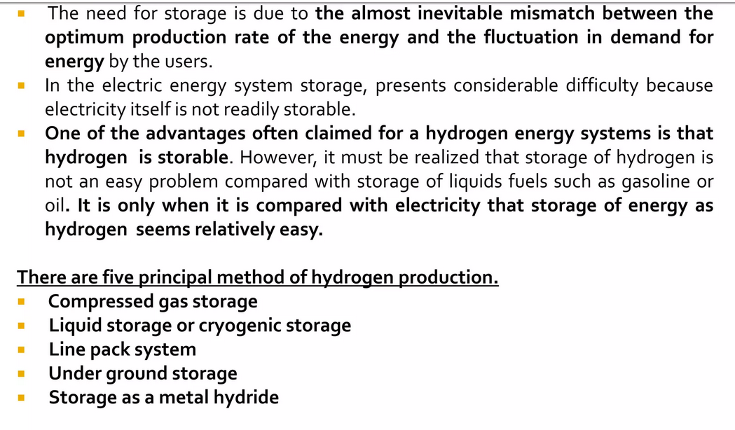
Hydrogen Storage
RV College of
Engineering®
Go, change the world

Slide 27
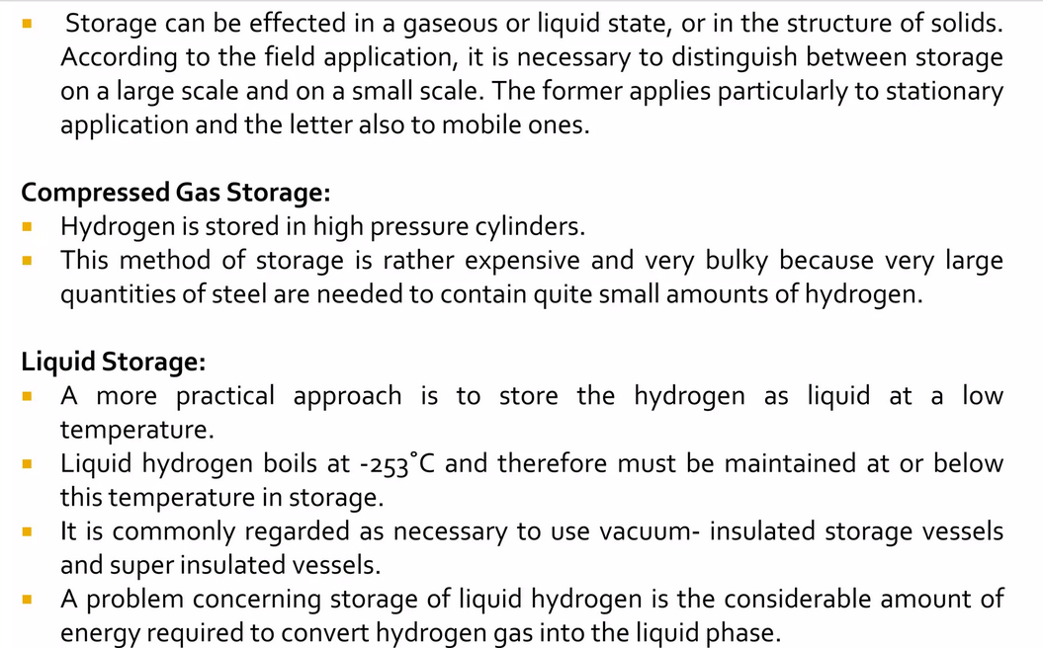
Storage
RV College of
Engineering®
Go, change the world

Slide 28
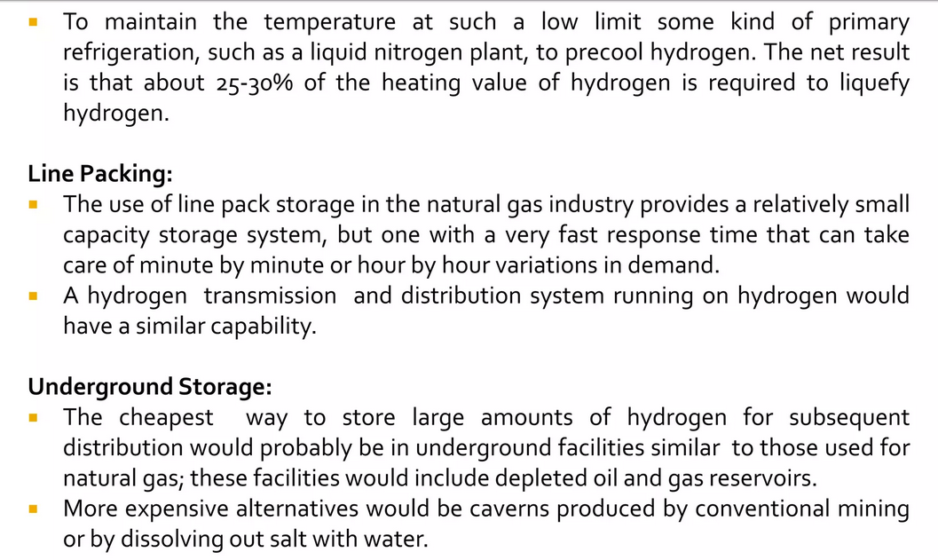
Storage
RV College of
Engineering®
Go, change the world

Slide 29
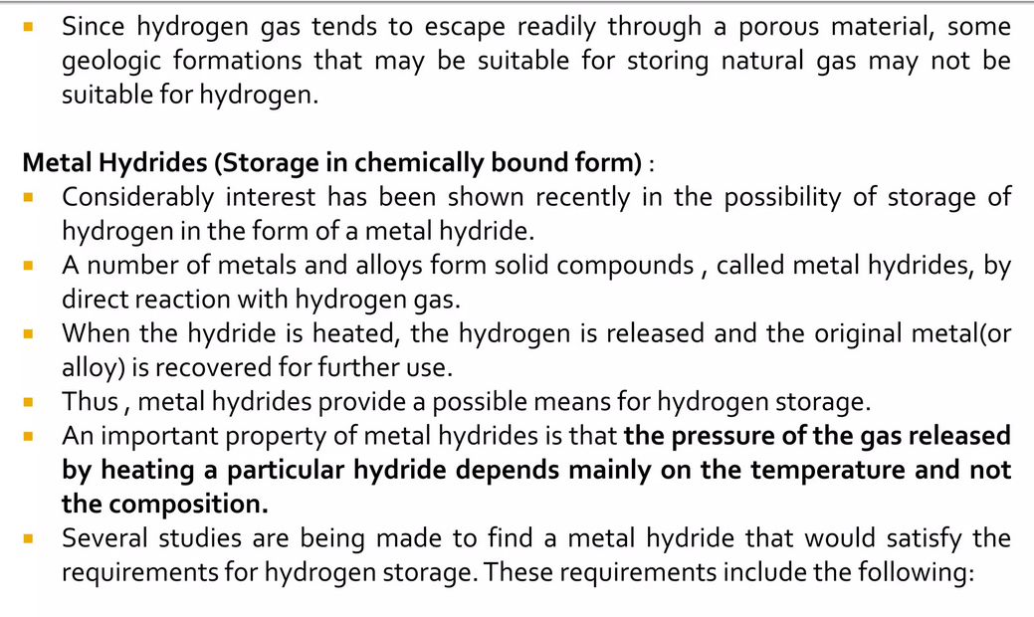
Storage
RV College of
Engineering®
Go, change the world

Slide 30
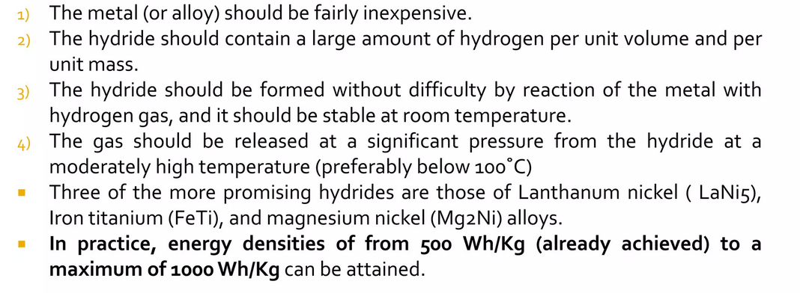
Storage
RV College of
Engineering®
Go, change the world

Slide 31
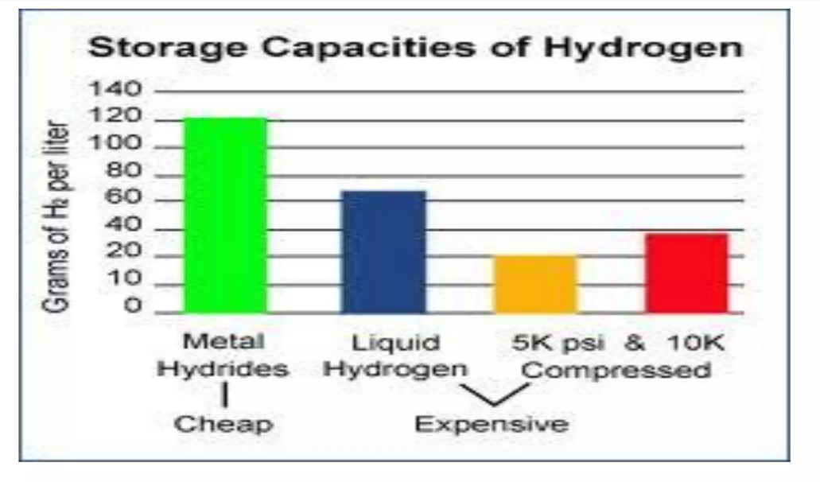
Storage Capacities
RV College of
Engineering®
Go, change the world

Slide 32
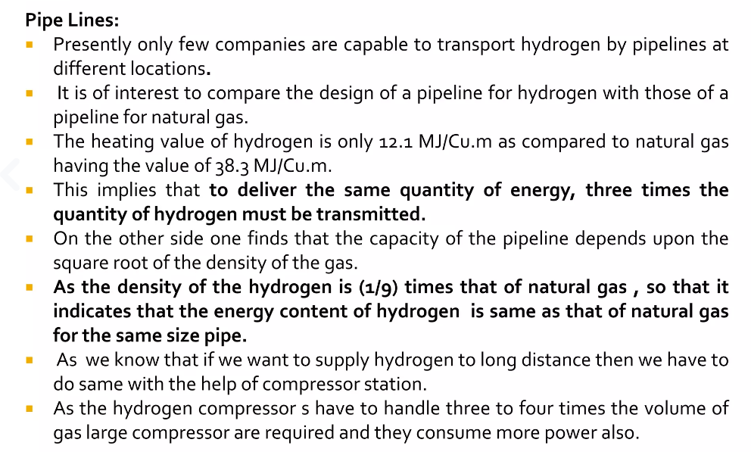
Pipelines

Slide 33
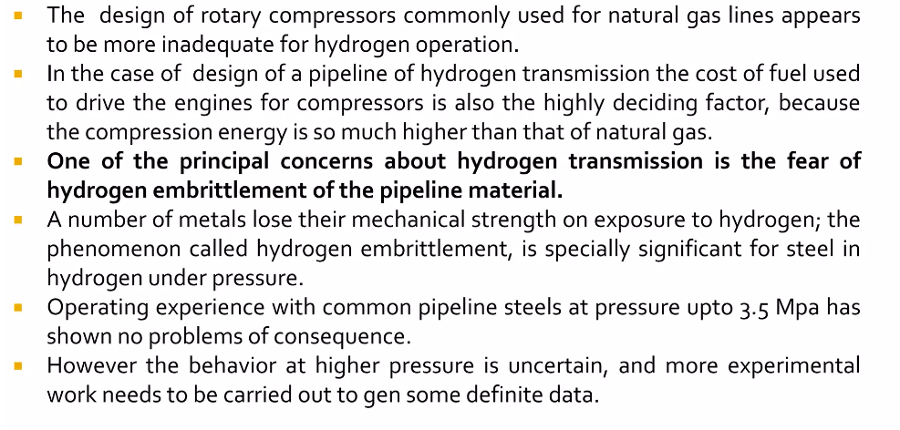
Pipelines

Slide 34
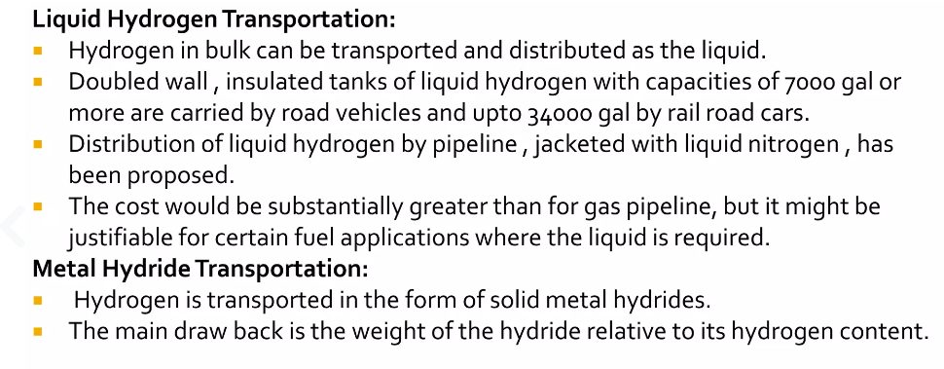
Pipelines

Slide 35
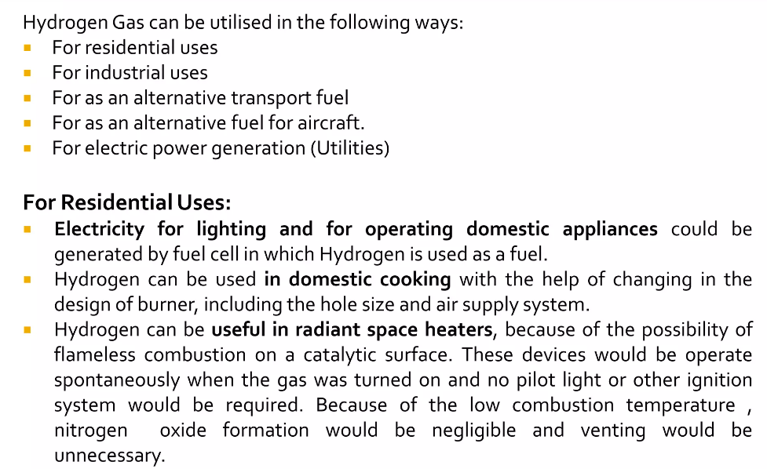
Utilization of Hydrogen Energy

Slide 36
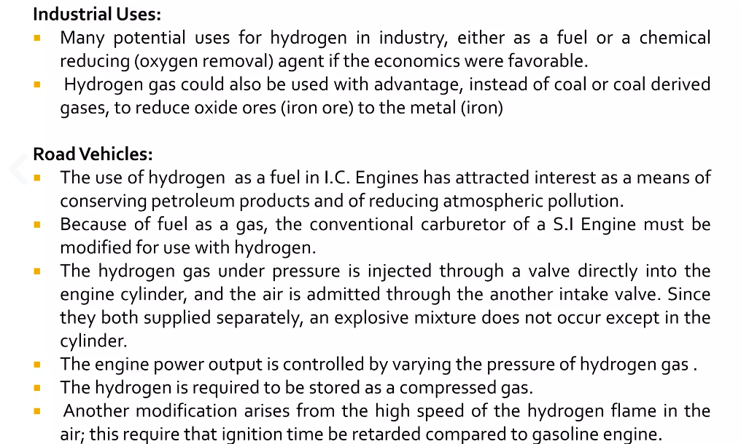
Utilization of Hydrogen Energy

Slide 37
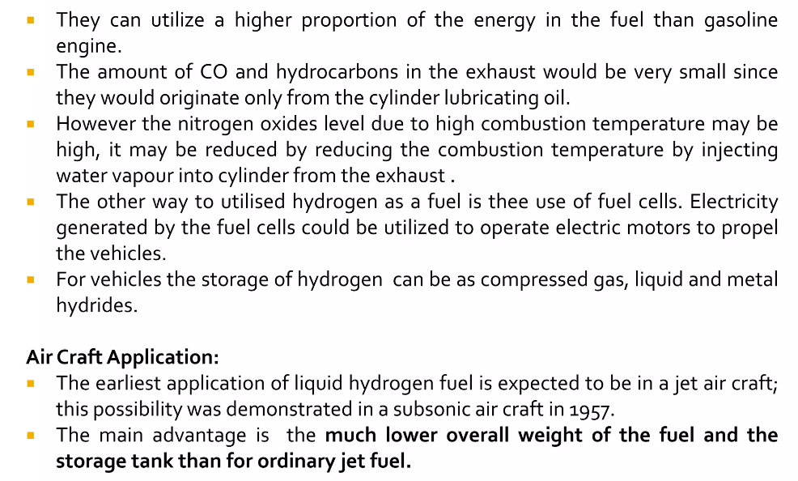
Advantages of H2 Energy

Slide 38
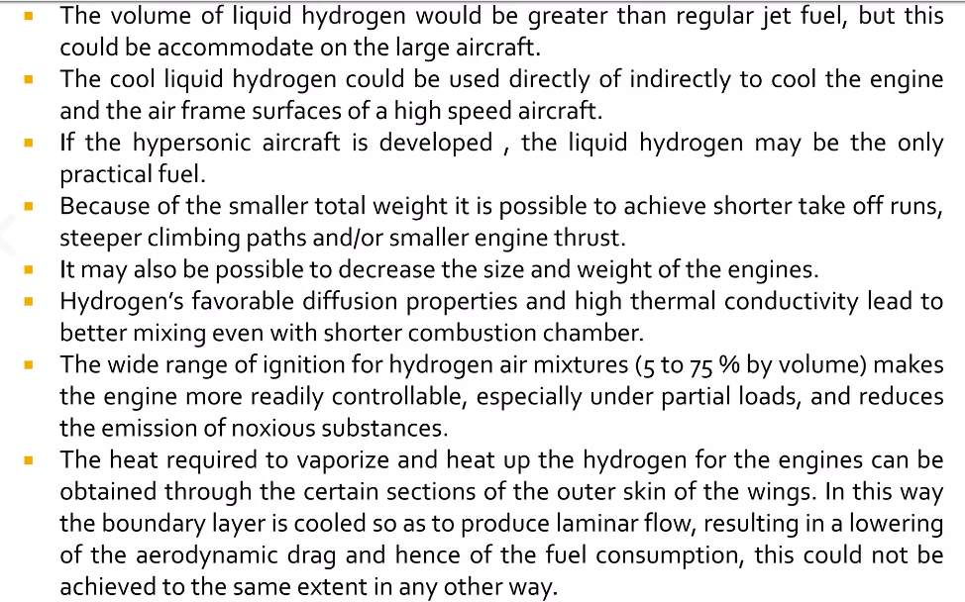
Advantages of H2 Energy

Slide 39
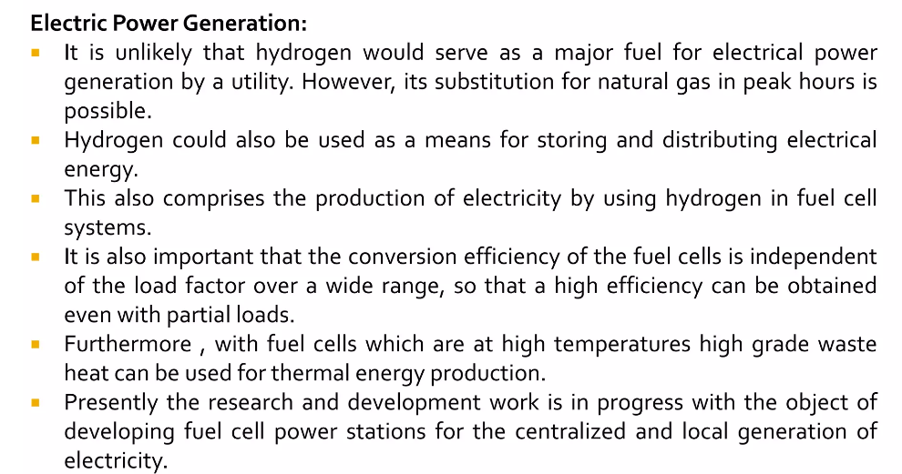
Advantages of H2 Energy

Slide 40
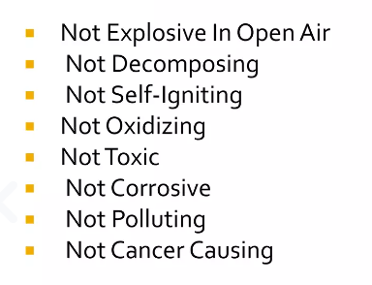
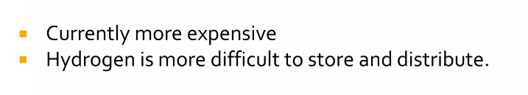
Advantages and Disadvantages of H2 Energy
Disadvantages

Slide 41
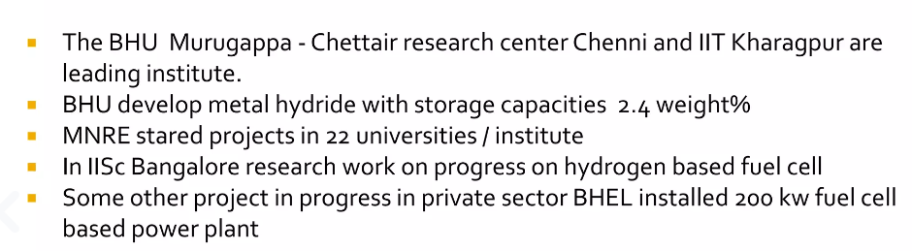
Status of H2 Energy

Slide 42
Thank You

